Slide 1

An Introduction to Information Systems
Pertemuan 1
Dr. Dedi Trisnawarman

Slide 2
Data, Information, and Knowledge
data: Raw facts such as an employee number or total hours worked in a week.
information: A collection of data organized and processed so that it has additional value beyond the value of the individual facts.
process: A set of logically related tasks performed to achieve a defined outcome.
knowledge: The awareness and understanding of a set of information and the ways that information can be made useful to support a specific task or reach a decision.

Slide 3
Process of transforming data into information
Transforming data into information starts by selecting data, then organizing it, and finally manipulating the data.

Slide 4
Information System (IS):
A set of interrelated components that collect, process, store, and disseminate data and information; an information system provides a feedback mechanism to monitor and control its operation to make sure it continues to meet its goals and objectives.
computer-based information system (CBIS): A single set of hardware, software, databases, networks, people, and procedures that are configured to collect, manipulate, store, and process data into information.

Slide 5
Characteristics of quality information
Accessible Accurate Complete Economical Flexible | Relevant Reliable Secure Simple Timely Verifiable

Slide 6
Technology Infrastructure:
All the hardware, software, databases, networks, people, and procedures that are configured to collect, manipulate, store, and process data into information.

Slide 7
Information Systems in Organizations
personal IS: An information system that improves the productivity of individual users in performing stand-alone tasks.
group IS: An information system that improves communications and support collaboration among members of a workgroup.
enterprise IS: An information system that an organization uses to define structured interactions among its own employees and/or with external customers, suppliers, government agencies, and other business partners.

Slide 8
Information Systems in Organizations
 | Personal IS | Group IS | Enterprise IS
Example | Personal productivity software, decision-support system | Email, instant messaging, project management software | Transaction processing systems, enterprise systems, interorganizational systems
Benefits | Improved productivity | Increased collaboration | Increased standardization and ability to monitor work

Slide 9
Information Technology Concepts
hardware: Computer equipment used to perform input, processing, storage, and output activities.
software: The computer programs that govern the operation of a particular computing device, be it desktop, laptop, tablet, smartphone, or some other device.

Slide 10
Database Systems and Big Data
database: An organized collection of facts and information, typically consisting of two or more related data files.
data warehouse: A database that stores large amounts of historical data in a form that readily supports analysis and management decision making.
extract-transform-load (ETL): The process by which raw data is extracted from various sources, transformed into a format to support the analysis to be performed, and loaded into the data warehouse.
big data: A term used to describe data collections that are so enormous (think petabytes or larger) and complex (from sensor data to social media data) that traditional data management software, hardware, and analysis processes are incapable of dealing with them.

Slide 11
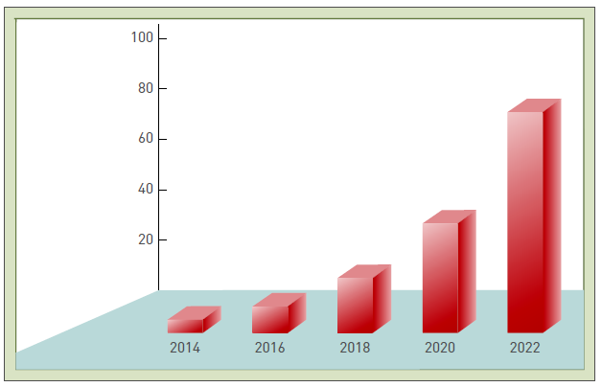
The size of the digital universe (zettabytes) doubles every two years

Slide 12
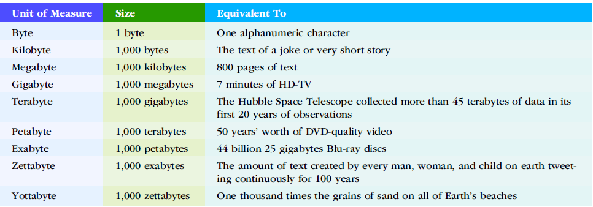
Units of measure for data

Slide 13
network:
A group or system of connected computers and equipment—in a room, building, campus, city, across the country, or around the world—that enables electronic communication.

Slide 14
Internet:
The world’s largest computer network, consisting of thousands of interconnected networks, all freely exchanging information.

Slide 15
Public Cloud Computing:
A means of providing computing services wherein a service provider organization owns and manages the hardware, software, networking, and storage devices, with cloud user organizations (called tenants) accessing slices of shared resources via the Internet.

Slide 16
World Wide Web (WWW):
A network of links on the Internet to files containing text, graphics, video, and sound.

Slide 17
Intranet & extranet :
Intranet: A network that enables communication, collaboration, search functions, and information sharing between the members of an organization’s team using a Web browser.
extranet: A network based on Web technologies that allows selected outsiders, such as business partners and customers, to access authorized resources of a company’s intranet.

Slide 18
Internet of Things (IoT) & Everything :
A network of physical objects or “things” embedded with sensors, processors, software, and network connectivity capability to enable them to exchange data with the manufacturer of the device, device operators, and other connected devices.
Internet of Everything: A network that encompasses not only machineto- machine but also people-to-people and people-to-machine connections.

Slide 19
Business Information Systems
Accounting and finance.
Customer service.
Human resources.
Manufacturing.
Research and development.
Sales and marketing.

Slide 20
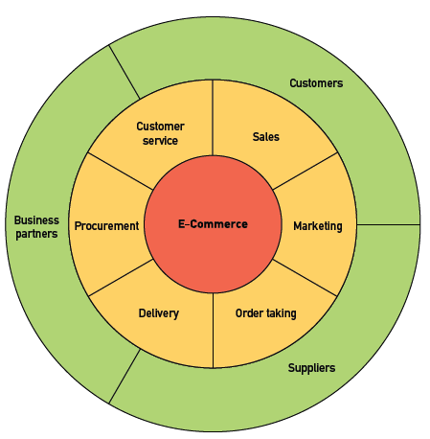
e-commerce:
Involves the exchange of money for goods and services over electronic networks and encompasses many of an organization’s outwardfacing processes—such as sales, marketing, order taking, delivery, procurement of goods and services, and customer service—that touch customers, suppliers, and other business partners.

Slide 21
m-commerce & e-business
mobile commerce (m-commerce): The buying and selling of goods and/or services using a mobile device, such as a tablet, smartphone, or other portable device.
electronic business (e-business): The use of information systems and networks to perform business-related tasks and functions beyond those performed for e-commerce.

Slide 22
Transaction Processing System (TPS):
transaction: Any business-related exchange such as a payment to an employee, a sale to a customer, or a payment to a supplier.
transaction processing system (TPS): An organized collection of people, procedures, software, databases, and devices used to process and record business transactions.

Slide 23
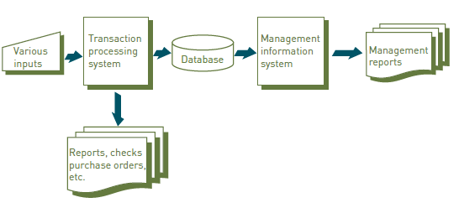
Management Information System:
An organized collection of people, procedures, software, databases, and devices that provides routine information to managers and decision makers.

Slide 24
Enterprise Resource Planning (ERP) system:
A system that supports an organization’s routine business processes, maintains records about those processes, and provides extensive reporting and data analysis capabilities.

Slide 25
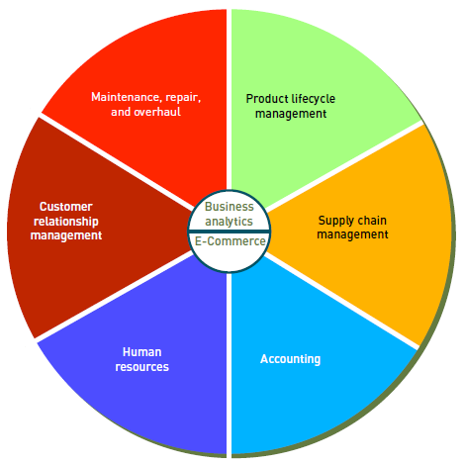
Primary components of an ERP system
for a manufacturing organization:
Supply chain management
Customer relationship management
Product lifecycle management
Maintenance, repair, and operations
Accounting
Human resource management

Slide 26
Enterprise Resource Planning (ERP) software
SAP AG, a German software company, is one of the leading suppliers of ERP software. The company employs more than 50,000 people in more than 130 countries.

Slide 27
Business Intelligence (BI):
A wide range of applications, practices, and technologies for the extraction, transformation, integration, visualization, analysis, interpretation, and presentation of data to support improved decision making.

Slide 28
Business Analytics:
The extensive use of data and quantitative analysis to support fact-based decision making within organizations.

Slide 29
Data Scientist:
A person who understands the business and the business analytics technology, while also recognizing the limitations of their data, tools, and techniques; a data scientist puts all of this together to deliver real improvements in decision making with an organization.

Slide 30
Knowledge Management System (KMS):
An organized collection of people, procedures, software, databases, and devices that stores and retrieves knowledge, improves collaboration, locates knowledge sources, captures and uses knowledge, or in some other way enhances the knowledge management process.

Slide 31
Planning, Acquiring, and Building Systems
project: A temporary endeavor undertaken to create a unique product, service, or result.
system acquisition: The process used to obtain the information system resources needed to provide the services necessary to meet a specific set of needs.
system development: The activity of building information systems to meet users’ needs.

Slide 32
Cybercriminal:
A computer hacker who is motivated by the potential for monetary gain; cybercriminals hack into computer systems to steal, often by transferring money from one account to another or by stealing and reselling credit card numbers, personal identities, and financial account information.

Slide 33
Cyberterrorism:
The intimidation of a government or a civilian population by using information technology to disable critical national infrastructure (e.g., energy, transportation, financial, law enforcement, emergency response) to achieve political, religious, or ideological goals.

Slide 34
Ethics:
A set of beliefs about right and wrong behavior. Ethical behavior conforms to generally accepted social norms—many of which are almost universally accepted.

Slide 35
Digital Divide:
The gulf between those who do and those who don’t have access to modern information and communications technology such as smartphones, personal computers, and the Internet.

Slide 36
Net Neutrality:
The principle that Internet service providers (ISPs) should be required to treat all Internet traffic running over their wired and wireless broadband networks the same— without favoring content from some sources and/or blocking or slowing (also known as throttling) content from others.

